Slide 1





SC2001
Project 1
TEAM 7
Nguyen An Loc
Ooi Jia xi
Panicker Shobith Shreekumar

Slide 2

Project 1: Integration of Mergesort and Insertion Sort
1. Algorithm implementation
Implement and analyze the hybrid algorithm
2. Generate input data Generate arrays of increasing sizes, in a range from 1,000 to 10 million
4.Compare with Mergesort
3. Analyze Time complexity
Determine optimal value of S
Compare performance with the original Mergesort in lecture

Slide 3

Motivation for Hybrid Sort
MergeSort efficient overall but has recursion overhead on small subarrays
Insertion Sort is simple and efficient for small subarrays
Hybrid approach: combine both for better performance
Use MergeSort for large subarrays
Switch to Insertion Sort when subarray size ≤ threshold S
Balances divide-and-conquer with localized efficiency

Slide 4
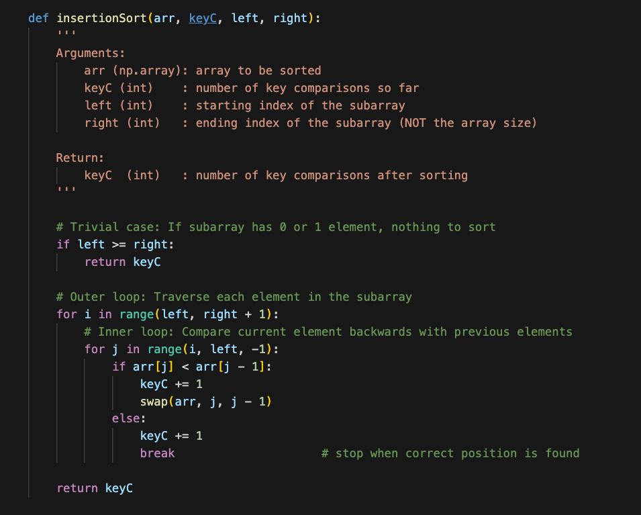

Part (a): Algorithm implementation
1
Insertion Sort

Slide 5
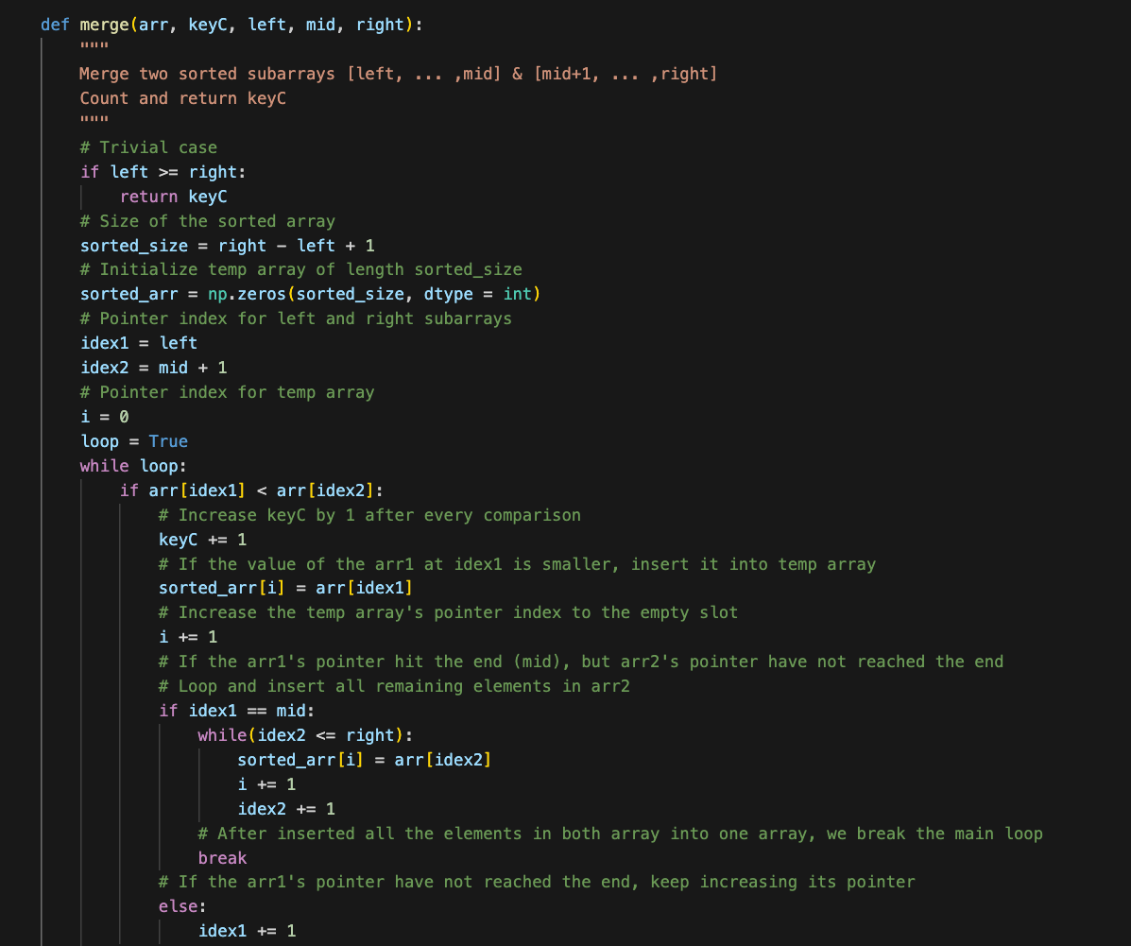
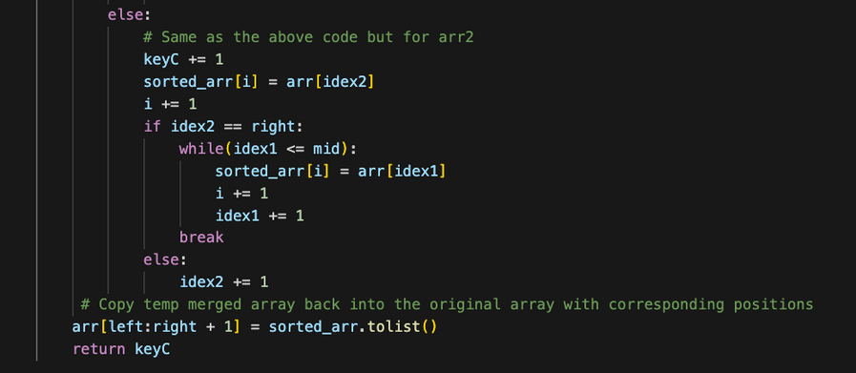
Part (a): Algorithm implementation
2
Merge the two sorted subarrays

Slide 6
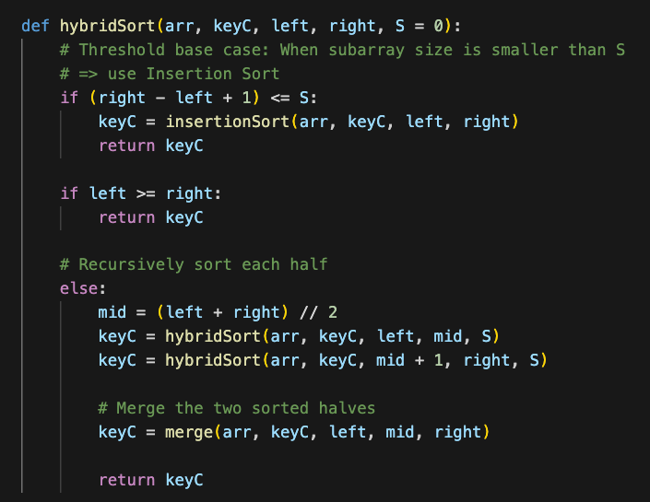
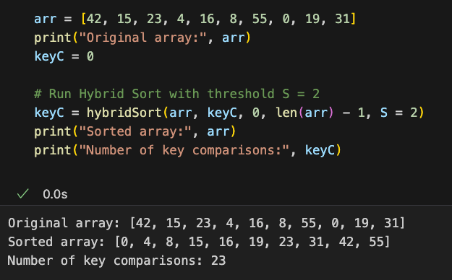
Part (a): Algorithm implementation
3
4
Hybrid Sort
Testing
This hybridSort() adds an extra argument from the original mergeSort(), allow us to set an 'S' value.
When S = 0, the algorithm behaves exactly like the mergeSort() taught in lectures.

Slide 7
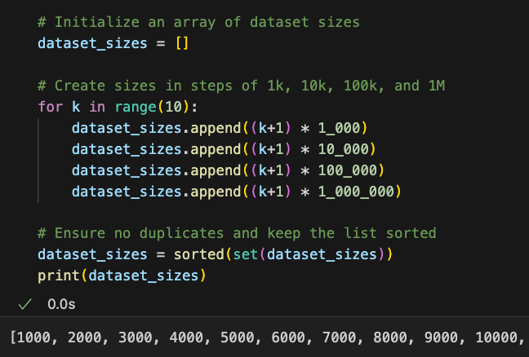
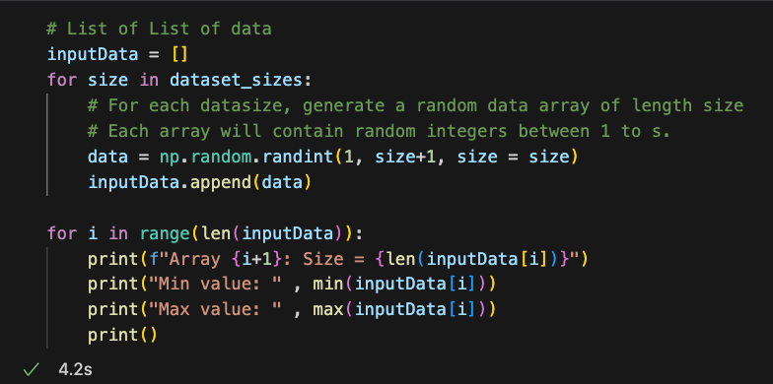
(b) Generate input data
1. Define dataset sizes
2. Generate the datasets

Slide 8
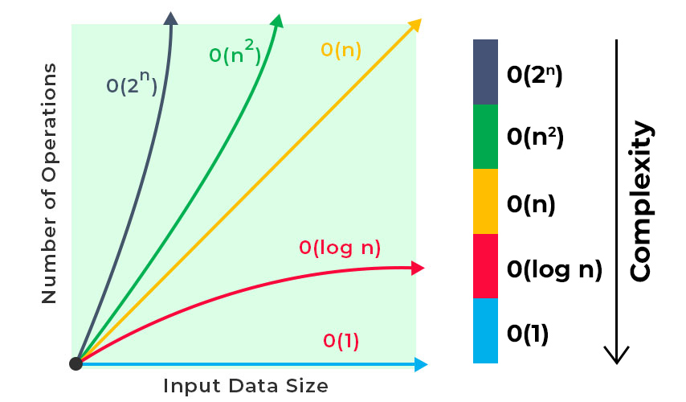
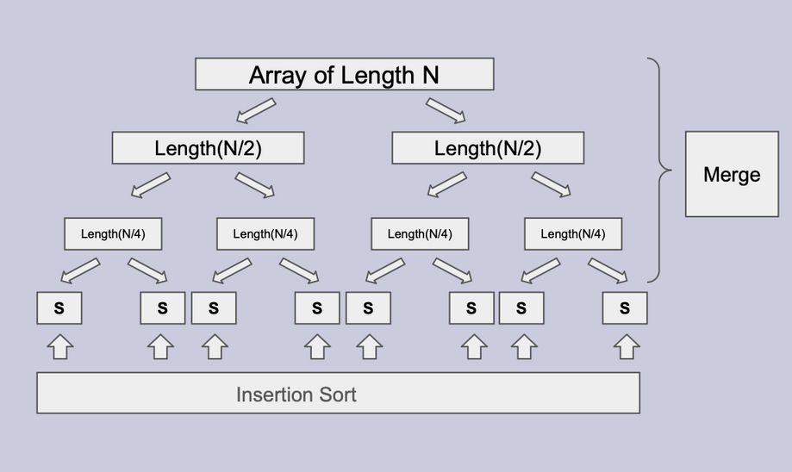
Part (c): Analysis of time complexity
THEORETICAL TIME COMPLEXITY
Algorithm | Best Case | Worst Case | Average Case
MergeSort | O(n log n) | O(n log n) | O(n log n)
Insertion Sort | O(n) | O(n2) | O(n2)
Hybrid Sort | O(n log(n/S)+ n) | O(n log(n/S)+ nS) | O(n log(n/S)+ nS)
n: the number of elements in the array you’re sorting (input size).
S: the cutoff threshold at which the algorithm stops recursing and switches from mergesort to insertion sort for any subarray of size ≤S.

Slide 9
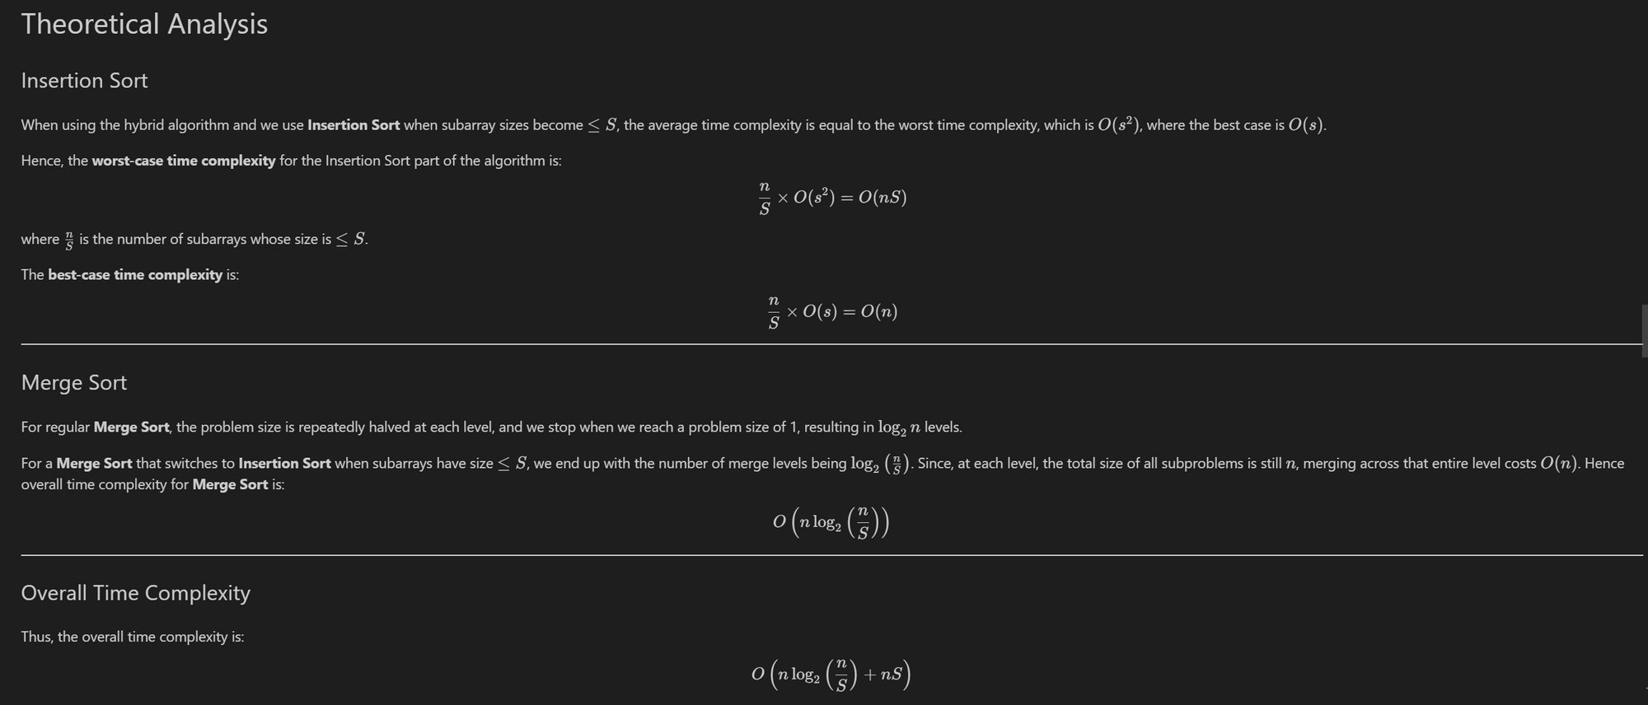
Part (c): Analysis of time complexity
Theoretical time complexity
n: the number of elements in the array you’re sorting (input size)
S: the cutoff threshold at which the algorithm stops recursing & switches from mergesort to insertion sort for any subarray of size ≤ S.

Slide 10
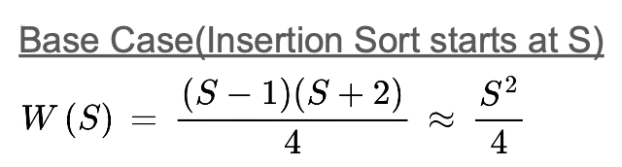
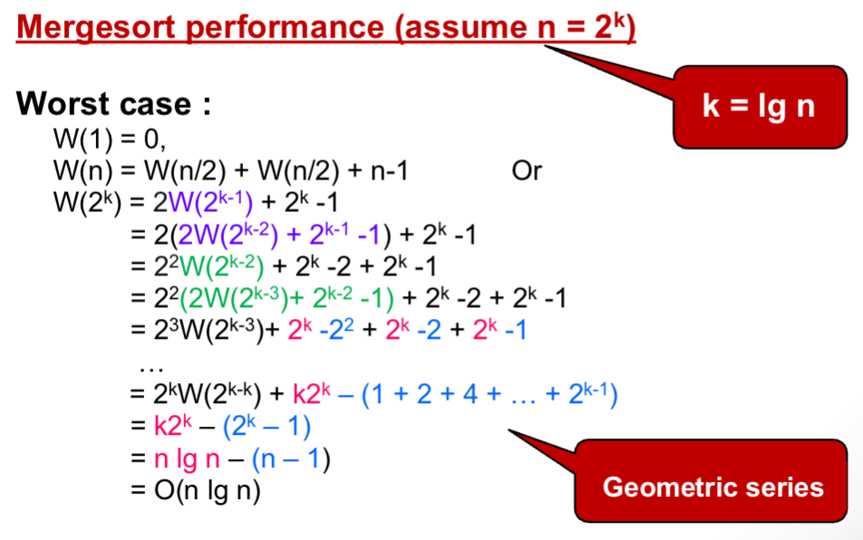
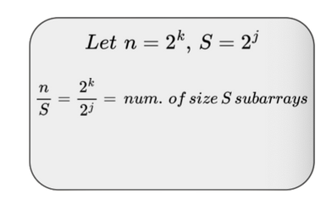
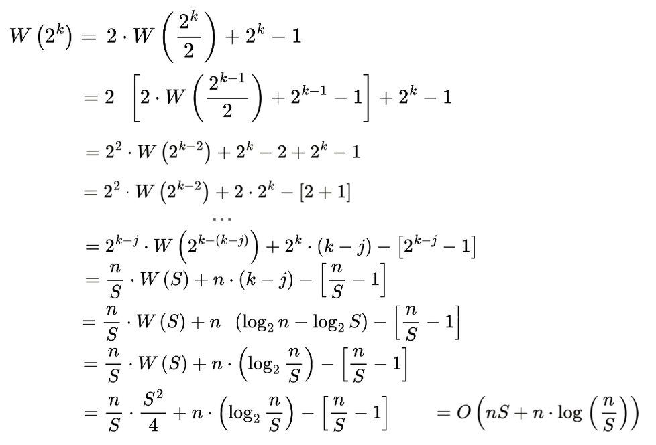
Part (c): Analysis of time complexity
FIX S VARY N (THEORETICAL)

Slide 11
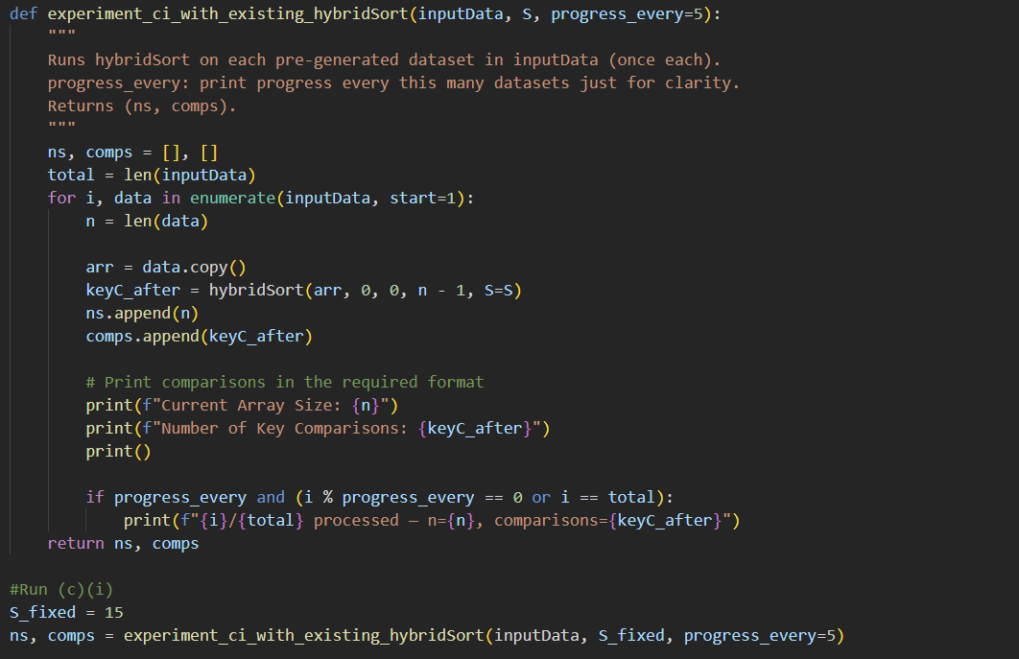
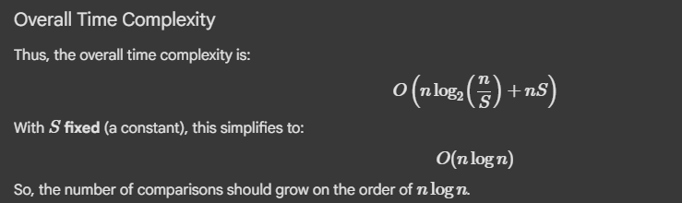
Part c(i): Analysis of time complexity
Fix S vary n (Code)

Slide 12
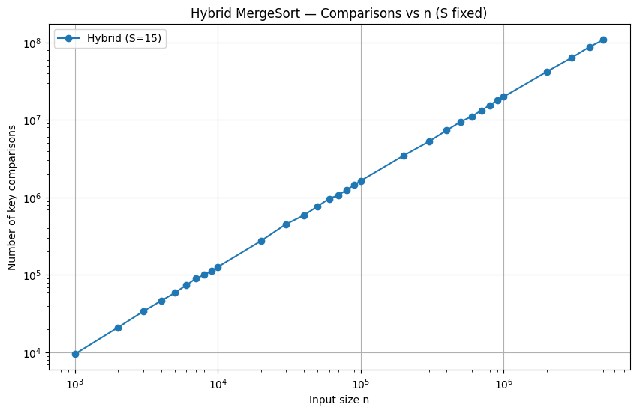
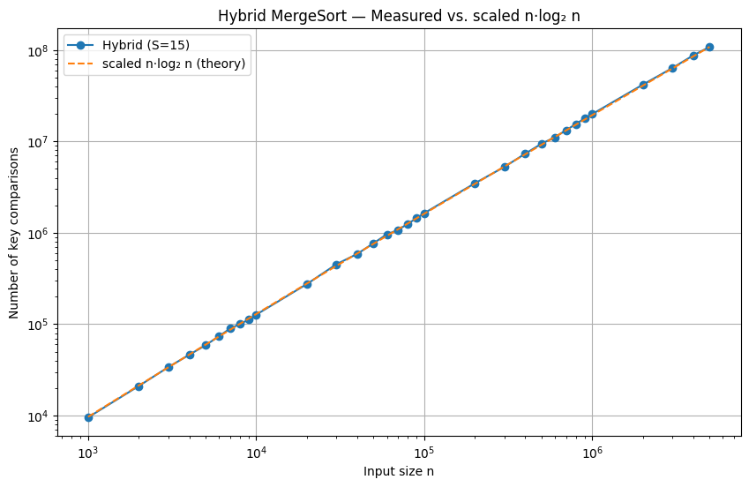
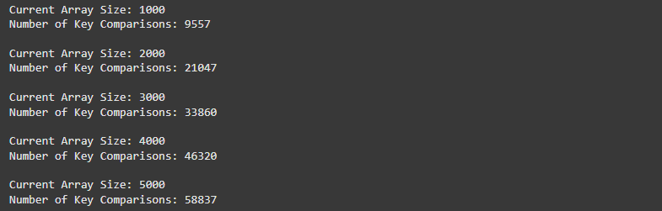
Part c(i): Analysis of time complexity
Fix S vary n

Slide 13
Part (c)ii: Analysis of time complexity
Rationale for choice of thresholds (S values)
For very small S (2, 4):
Almost always using MergeSort.
High recursion overhead.
Runtime larger.
For medium S (8, 16, 32):
Balanced use of MergeSort + InsertionSort.
Runtime minimized around here (usually between 8 and 32).
For large S (64, 128):
Large subarrays handled by InsertionSort.
Runtime increases rapidly because InsertionSort is O(n^2).
So the rationale is: By choosing exponentially increasing S values, we cover the whole range of possible trade-offs between recursion overhead and insertion overhead.

Slide 14
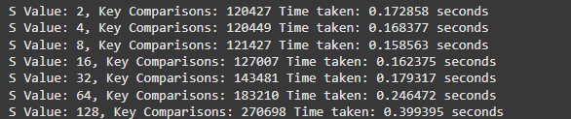
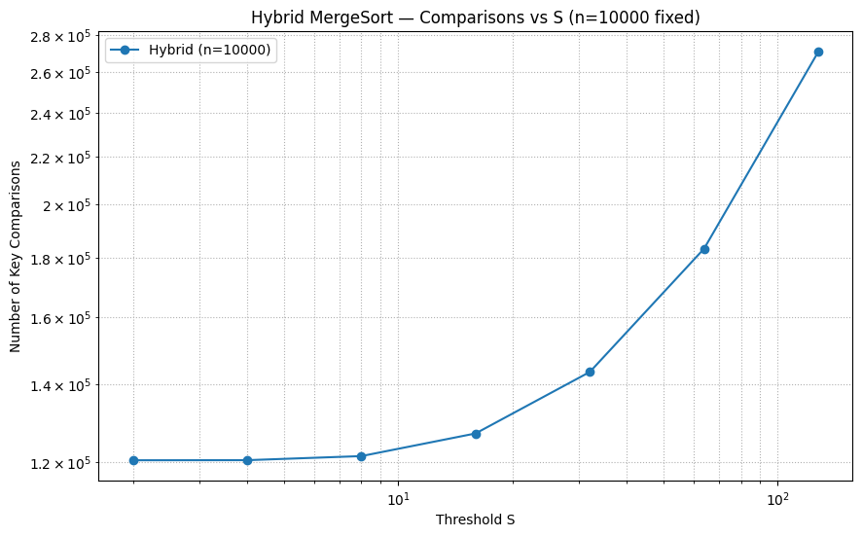
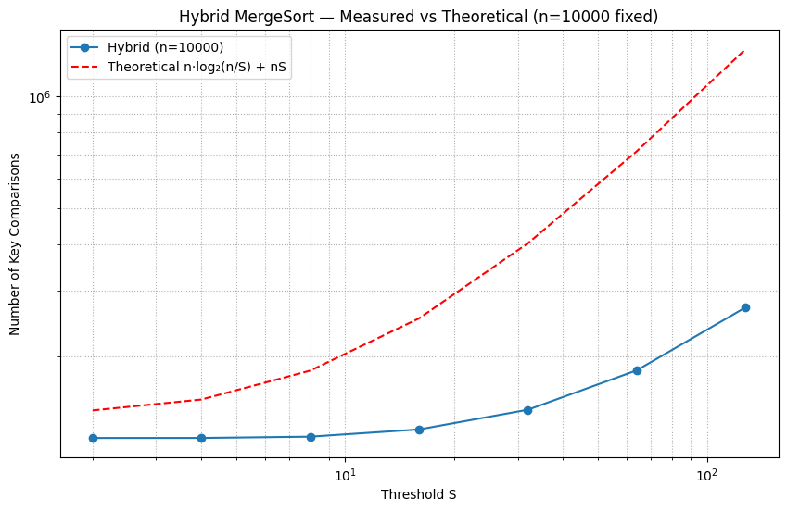
Part (c)ii
Fix N vary S

Slide 15
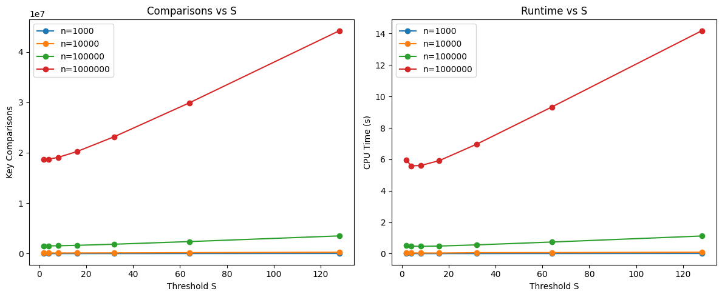
Part (c)iii : Finding optimal S
Comparisons ↑ as S increases (insertion sort dominates).
Runtime forms U-shape.
(small S lead to recursion overhead, large S makes insertion sort too slow)
Lowest runtime at S = 4.
Notes:
Now I’ll talk about part (c)(iii), which is about finding the optimal threshold S for the hybrid mergesort.
The idea is that mergesort is efficient for large inputs, but when the subarrays get very small, insertion sort can actually work faster. So, we introduce a cutoff value S: if the subarray size is smaller than S, we switch to insertion sort.
To find the best S, we ran experiments on datasets of different sizes. We measured the number of key comparisons as we varied S.
From the graph, we observed that when S is too small, mergesort dominates and performance is worse. When S is too large, insertion sort takes over too much and again becomes inefficient. But there is a sweet spot in the middle — for our data, this was around S = 20. That means the hybrid algorithm is most efficient when subarrays of size 20 or smaller are sorted using insertion sort.

Slide 16
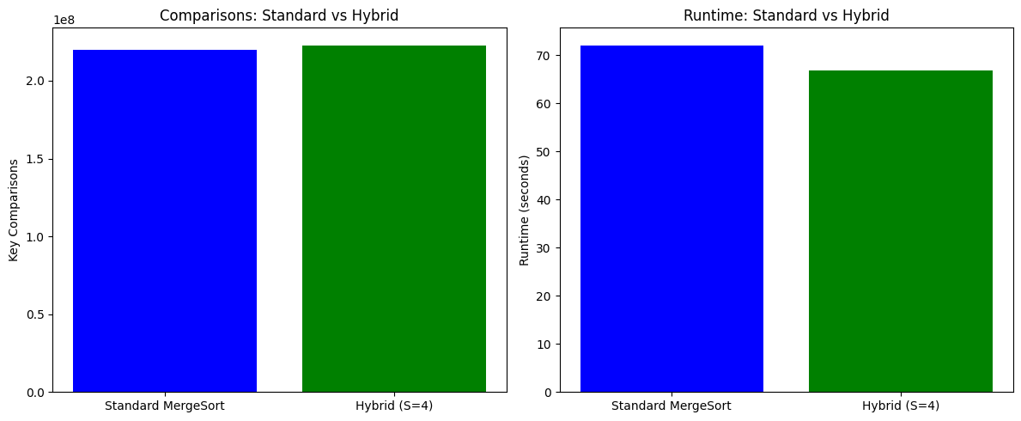
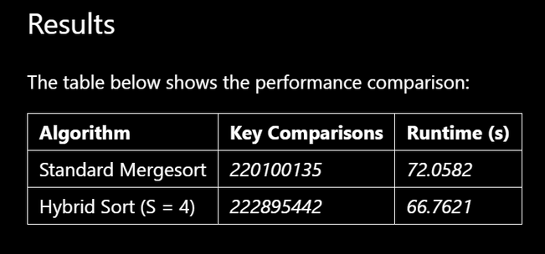
Part (d) : Standard Mergesort vs. Hybrid Sort
Using dataset with 10 million integers and S = 4,
Hybrid Sort shows similar number of comparisons to standard Mergesort but shorter runtime.

Slide 17





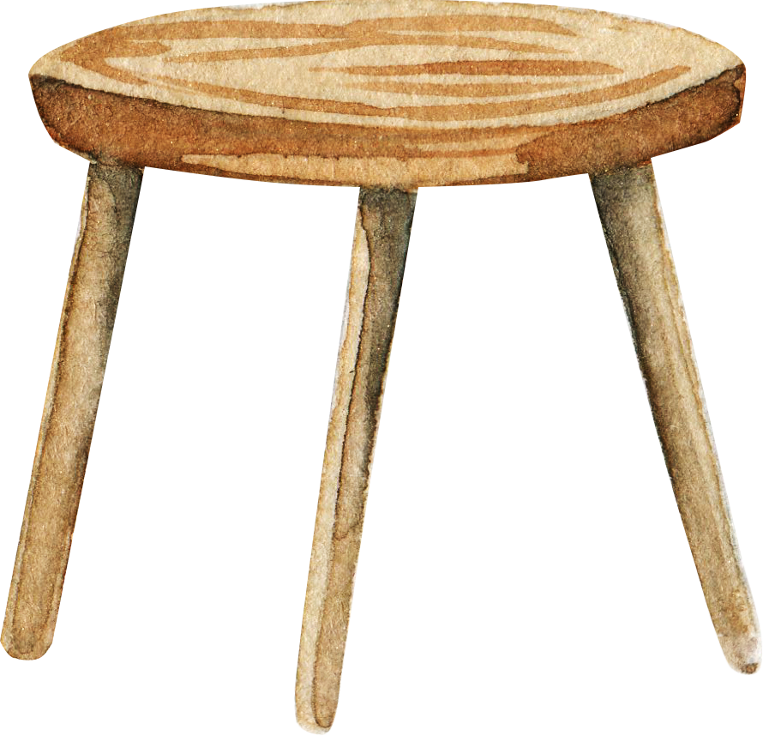

THANK YOU!

